Slide 1
Mobile Price Range Prediction
By-Kashfur Rahman khan

Slide 2
CONTENT
1)Problem Statement
2)Overview of Data
3)Exploratory Data Analysis
4)Model Preparation
5) Building Model
6)Conclusion

Slide 3
PROBLEM STATEMENT
In the mobile phone market, companies need to understand how different features of a phone (like RAM, internal memory, etc.) affect its selling price. The goal is to find a relationship between these features and the price range of the phone, indicating whether it is priced high or low. We do not need to predict the exact price of the phone, just the price range it falls into.

Slide 4
Data Description
1)Battery_power - Total energy a battery can store
2)Clock_speed - speed at which microprocessor executes instruction
3)Dual_sim - Has dual sim support or not
4)Fc - Front Camera mega pixels
5)Four_g - Has 4G or not
6)Int_memory - Internal Memory in Gigabytes
7)M_dep - Mobile Depth in cm
8)Mobile_wt - Weight of mobile phone
9)N_cores - Number of cores of processor
10)Pc - Primary Camera mega pixels
11)Px_height - Pixel Resolution Height
12)Px_width - Pixel Resolution Width
13)Ram - Random Access Memory in Mega
14)Touch_screen - Has touch screen or not
15)Wifi - Has wifi or not
16)Sc_h - Screen Height of mobile in cm
17)Sc_w - Screen Width of mobile in cm
18)Talk_time - longest time that a single battery charge will last
19)Three_g - Has 3G or not
20)Wifi - Has wifi or not
21)Price_range - This is the target variable

Slide 5
Exploratory Data Analysis
data information
mobile_data_df.info()
data description
mobile_data_df.describe()
checking whether there is null values or not
mobile_data_df.isnull().sum()

Slide 6
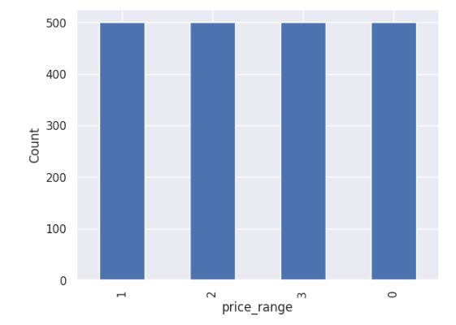
Mobile price ranges

Slide 7
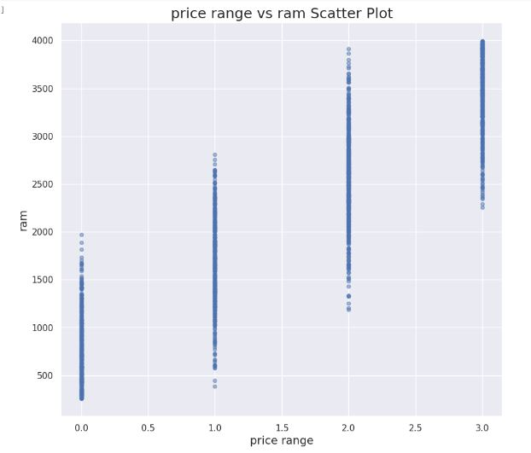
price range vs ram

Slide 8
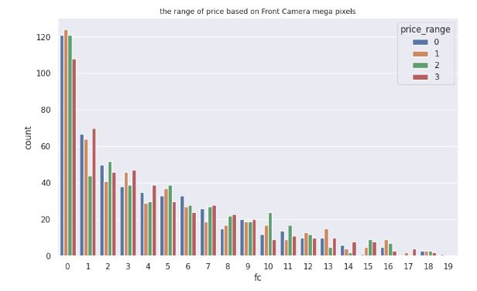
Range of price based on Front camera

Slide 9
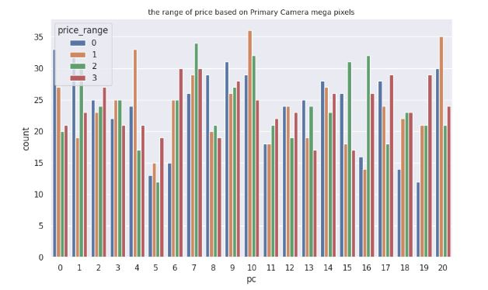
Range of price based on Primary camera

Slide 10
Checking Multicollinearity
Checking for multi-collinearity
correlation = mobile_data_df.corr()
plt.figure(figsize = [15, 15])
sns.heatmap(correlation, cmap = 'coolwarm', annot = True,annot_kws={"size": 10})

Slide 11
MODELING DATA
X = mobile_data_df.drop(['price_range'], axis = 1)
y = mobile_data_df['price_range']
from sklearn.preprocessing import MinMaxScaler
scaler = MinMaxScaler()
X_scaled = scaler.fit_transform(X)

Slide 12
Logistic Regression
Logistic regression is a statistical method used to analyze relationships between a binary (yes/no) outcome variable and one or more predictor variables.

Slide 13
Decision Tree
A decision tree is a type of machine learning algorithm used to make decisions or predictions by mapping out all possible outcomes of a series of decisions or events in a tree-like structure.

Slide 14
Conclusion
1)We are able to extract information and come to necessary information using Exploratary data analysis.
2)Used two machine learning models - Decision tree and Logistic Regression

